Slide 1
WAD PRESENTATION GROUP 5 BUG TRACKER
Lecturer: Dr.Nguyen Van Sinh

Slide 2
Team members
Võ Công Kha ITITIU18206 (25%)
Phạm Đăng Khoa ITITIU18276 (25%)
Hà Minh Chiến ITITIU18302 (25%)
Phạm Hàng Anh Tuấn ITITIU18179 (25%)

Slide 3
Table of contents
01
03
05
02
04
06
Introduction
System Design
Demo
Motivation and Objective
Entity R. Diagram
Table R. Diagram
Other Diagrams
Literature review
System Implementation
Conclusion
Platform and Tools
Similar Systems
List of completed works
Pros and Cons
Future Works

Slide 4
01
Introduction

Slide 5
Motivation and Objective
User may encounter unexpected features or errors when running applications → bugs / glitches
Gives user bad experience with the application overall
Bug reportings has been easier
Keep tracking and providing bug resolvement more rapidly

Slide 6
Learning outcome
Understand the Model – View – Control structure of a Web Application
Advance skills in developing Web frontend and backend
Improve skills in designing databases and UI in application
Practicing teamwork and problem solving

Slide 7
02
Literature review

Slide 8

Platforms and Tools
An open – source JavaScript library used for front-end user interface
Created originally by Jordan Walke
Currently maintained by Facebook and other community developers around the globe
Contains one of the most popular resources to create user interfaces due to its high performance, flexibility and the powerful support community

Slide 9

Platforms and Tools
An open – source web application framework for Node.js used for designing and building backend of web applications
Written in JavaScript that gives programmers and developers easier to build web applications.
Lightweight and can help organize one’s web application on the backend side into a secure Model – View – Control structure

Slide 10

Platforms and Tools
An open – source relational database management system (RDBMS)
Work with the host’s operating systems to implement a relational database in a computer's storage system, manages users, allows for network access and facilitates testing database integrity and creation of backups
Responsible to power storage solution of many popular websites, such as Flickr, MediaWiki, Twitter, YouTube and Facebook.

Slide 11
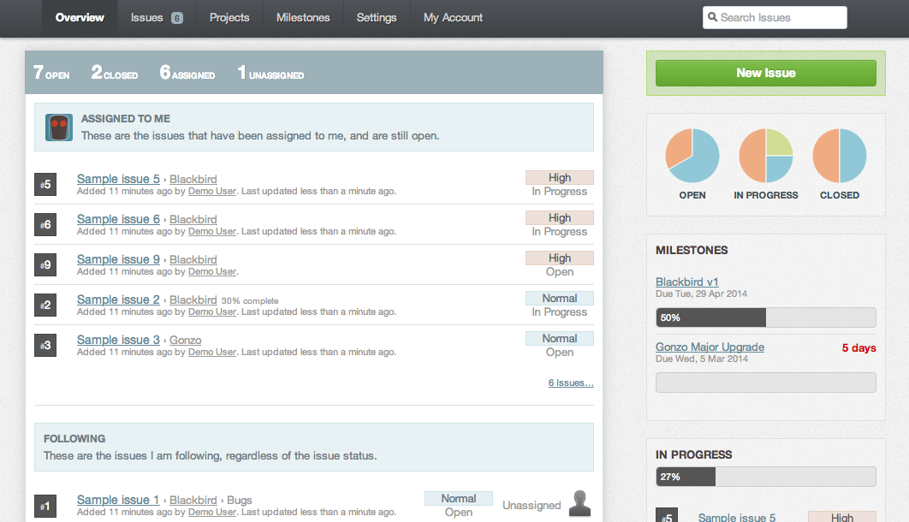
Similar Systems
Bugify - Simplified issue tracker

Slide 12
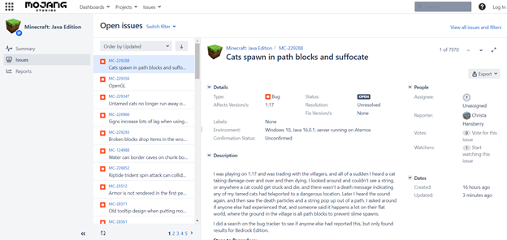
Similar Systems
Mojang’s Bugtracker

Slide 13
03
System Design
Menu

Slide 14
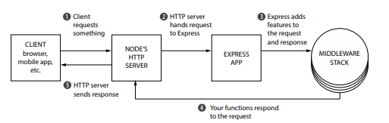
Workflow Structure

Slide 15
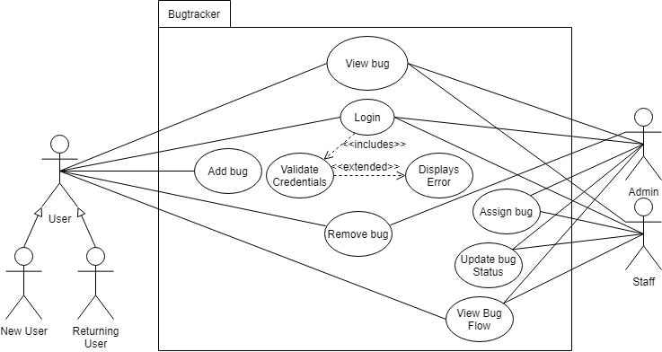
Use Case Diagram

Slide 16
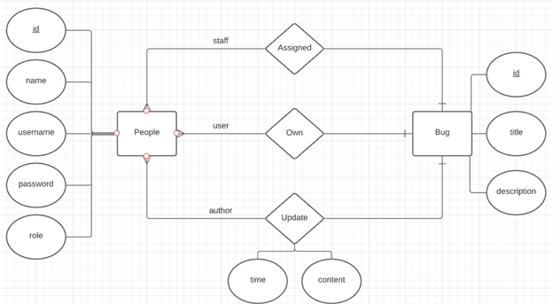
Entity Relationship Diagram

Slide 17
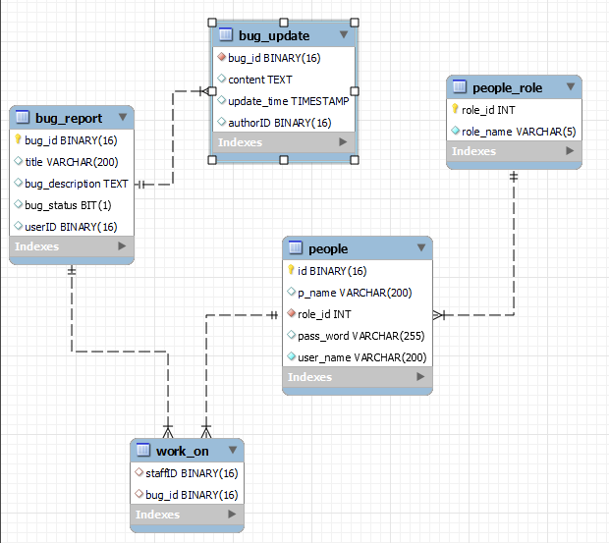
Table Relationship Diagram

Slide 18
04
System Implementation
Menu

Slide 19
System Implementation
We will show you the System Implementation directly in the Visual Studio Code

Slide 20
05
Demo
Menu

Slide 21
06
Conclusion
Menu

Slide 22
List of completed works
UI successfully displayed with no errors
Implemented the React frontend server and the Express backend server.
Testing shows expected results.

Slide 23
Pros and Cons
Pros
Cons
Information strictly secured by ‘bcrypt’ library
Lightweight, high performance application
Async, Await implementation to avoid the infamous Pyramid of Doom
Try/Catch the tower of Terror
Media such as images, videos are not supported
UI design is still decent, not very eye - catching

Slide 24
Future Work
Extend bug creation system to include medias
Implement search bug functionality
More detailed development on the Web UI
Integrate into mobile app with React Native

Slide 25
References
The Pyramid of Doom: callbackhell.com
https://en.wikipedia.org/wiki/React_(JavaScript_library)
Reactjs.org
Expressjs.com
reactjs.org/docs
en.wikipedia.org/wiki/MySQL

Slide 26
Thank you for your attention
Q&A

